Slide 1

Intro to Computer Science
Basis for the design and use of computers
SoftUni Team
Technical Trainers
Software University
http://softuni.bg

Slide 2
Table of Contents
Early Computing
Boolean logic and Logical gates
ALU (Arithmetic and Logic Units)
Registers, RAM
CPU - Instruction cycle

Slide 3
Have a Question?
sli.do
#TECH-FUND

Slide 4
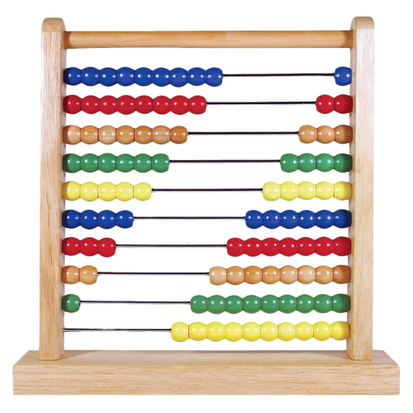
Early Computing

Slide 5
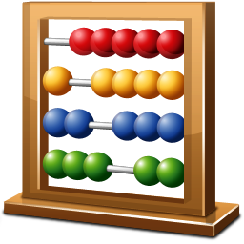
The Abacus
Calculating tool that was in use in Europe, China and Russia
Originally they were beans or stones moved in grooves in sand or on tablets of wood, stone, or metal.

Slide 6
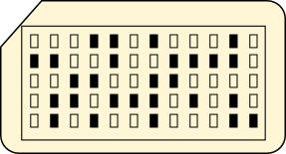
The Punched Card
Piece of stiff paper that can be used to contain digital data represented by the presence or absence of holes in predefined positions.
Widely used through much of the 20th century in the data processing industry

Slide 7
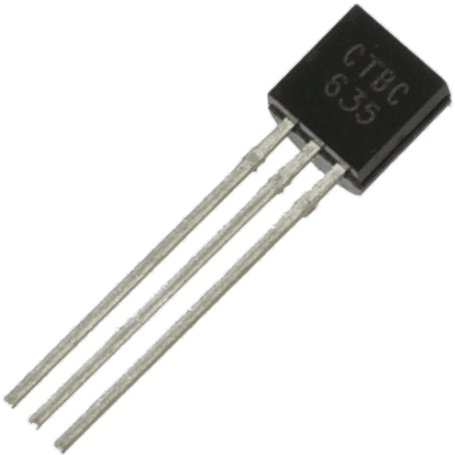
Transistors
Used to amplify or switch electronic signals and electrical power.
Has at least three terminals for connection to an external circuit.
The transistor is the fundamental building block of modern electronic devices

Slide 8
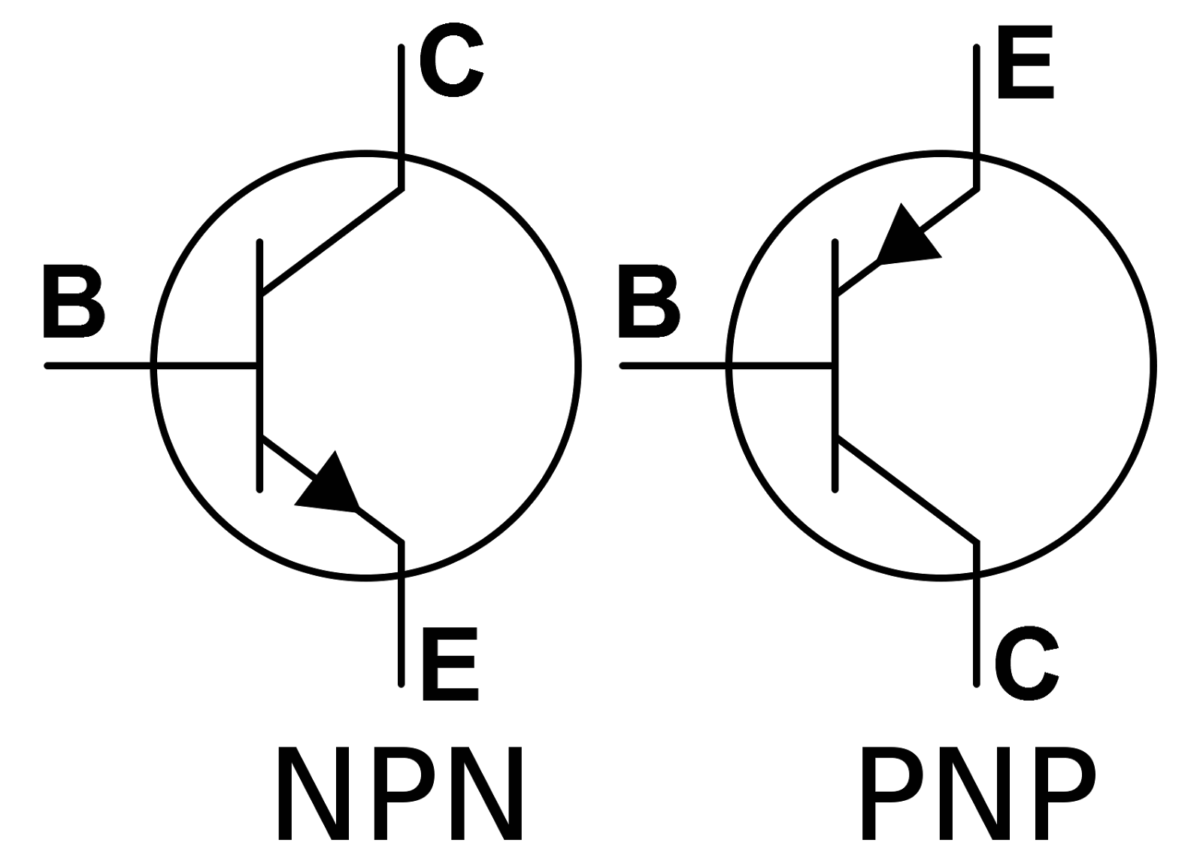
Structure of Transistors

Slide 9
Abstraction
level:
1 2 3 4 5
Boolean logic and Logical gates

Slide 10
Boolean Algebra
Branch of algebra in which the values of the variables are the truth values true and false, usually denoted 1 and 0 respectively
Formalism for describing logical relations
There are 4 logical operations:
NOT
AND
OR
XOR

Slide 11
NOT Operation
Takes a single value True or False and flips it
NOT gate:
output output
input input
Input | Output
True | False
False | True
off
on
on
off

Slide 12
AND Operation
Takes two input values and outputs a single value
Input A | Input B | Output
True | False | False
False | True | False
True | True | True
False | False | False

Slide 13
AND Gate
current
output
off
on
off
Input A
Input B
current
output
on
on
on
Input A
Input B

Slide 14
OR Operation
Takes two input values and outputs a single value
Input A | Input B | Output
True | False | True
False | True | True
True | True | True
False | False | False

Slide 15
OR Gate
current
output
on
Input A
Input B
on
off

Slide 16
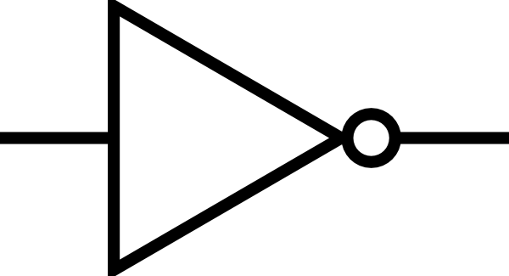
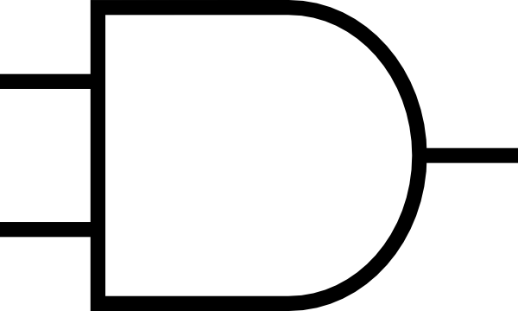
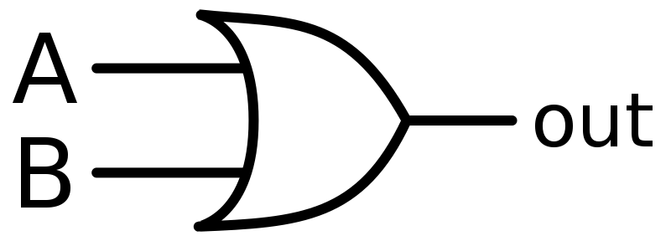
Logical operations notation
NOT:
AND:
OR:
From now on, we are going to use them like this

Slide 17
Abstraction
level:
1 2 3 4 5

Slide 18
XOR Operation
Takes two input values and outputs a single value
XOR is OR but not AND
Input A | Input B | Output
True | False | True
False | True | True
True | True | False
False | False | False

Slide 19
Problem: XOR Gate
Try to recreate how the XOR gate will look like
XOR is OR but not AND, so:
Include OR
Include AND
Include NOT after the AND
Connect all of them with AND

Slide 20

Solution: XOR Gate
Input A
AND
NOT
Input B
AND
Output
OR
XOR notation:
XOR

Slide 21
Abstraction
level:
1 2 3 4 5
ALU
Arithmetic and Logic Units

Slide 22
What is ALU
Electronic circuit that performs arithmetic and bitwise operations on integer binary numbers.
To sum binary numbers, we use the following:
To carry over we use AND gate
0 + 0 = 0
1 + 0 = 1
0 + 1 = 1
1 + 1 = 0 (1)
This is actually XOR
We carry over the 1

Slide 23


Half Adder
So to represent adding binary numbers we use XOR + AND
Half Adder notation:
Input A
XOR
sum
Input B
AND
carry
InA
C
HA
InB
S

Slide 24
Full Adder
To sum binary numbers, we have to send that 1 that we carried over to the next column
To do that, we just need to take that carried over 1 and send it as input to another half adder
We need two half adders to create full adder

Slide 25
Problem: Full Adder
Knowing what a half adder is, try creating full adder (used for carrying over ones)
Full adder is chaining two half adders:
Take a half adder
Make its sum an input to another half adder
The other input of the second adder will be a carry (if one)
Then add an OR gate to calculate the carry of the two half adders

Slide 26

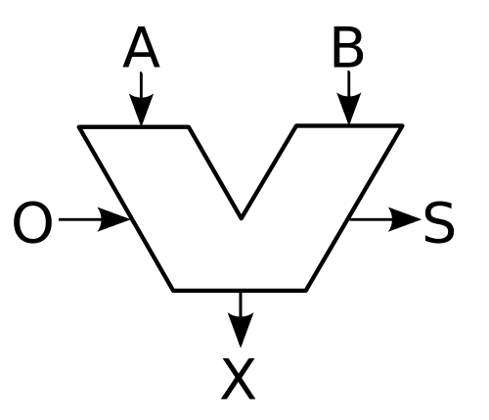
Solution: Full Adder
InA
C
HA
C
InB
S
InA
C
OR
HA
InB
C
S
So a full adder receives 3 inputs and produces two outputs (sum and carry)
Full Adder notation:
STATUS – 3 outputs (zero, negative, overflow).
OPCODE – 4 bit code to determine the operation (1000 – Add, 1100 - Subtract)

Slide 27
Abstraction
level:
1 2 3 4 5
Registers, RAM

Slide 28
Gated Latch
Circuit that has two stable states and can be used to store state information.
It has a third input that must be active in order for the SET and RESET inputs to take effect.
This third input is sometimes called ENABLE because it enables the operation of the SET and RESET inputs.

Slide 29
Gated Latch Structure
Input
AND
OR
Write
enable
NOT
AND
AND
NOT
Output
In
GL
Out
When turning Write enable on, we save the output
WE

Slide 30
8-bit Registers
D – data in
E – write enable
Q – data out
1
0
1
0
1
Q
D E
Q
D E
Q
D E
Q
D E
Q
D E
1
1
0
1
0
1

Slide 31
Multiplexer
Grid of many latches
Selects one of several analog or digital input signals and forwards the selected input into a single line.
Is used to increase the amount of data that can be sent over the network
Multiplexers can also be used to implement Boolean functions of multiple variables.
RAM contains many multiplexers

Slide 32
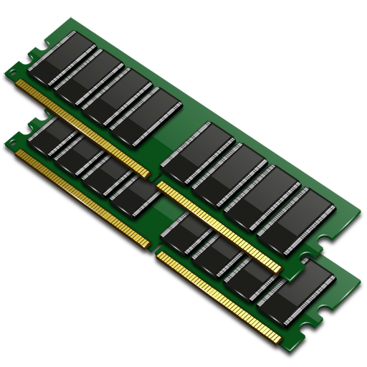
RAM
Stores data and machine code currently being used.
Allows data items to be read or written
Address | Data
0 | 001001
1 | 010010
2 | 011011
3 | 011101
4 | 101001
5 | 110110
… | …
8-bit data
8-bit address input
Write enable
Read enable

Slide 33
Abstraction
level:
1 2 3 4 5
CPU and Instruction cycle

Slide 34
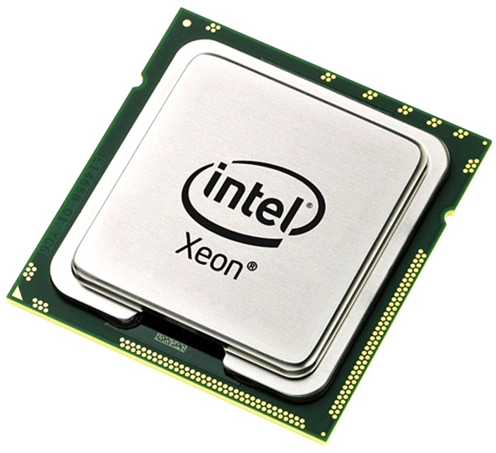
What is a CPU?
Carries out the instructions of a computer program by performing the basic arithmetic, logical, control and input/output (I/O) operations
Fundamental operation of most CPUs is to execute a sequence of stored instructions that is called a program.

Slide 35
Instructions Table
Instruction | Description | 4-bit opcode | Address/Register
LOAD_A | Read RAM location into register A | 0010 | 4-bit RAM address
LOAD_B | Read RAM location into register B | 0001 | 4-bit RAM address
STORE_A | Write from register A into RAM location | 0100 | 4-bit RAM address
ADD | Add two registers and store into second register | 1000 | 2-bit register ID, 2-bit register ID

Slide 36
Example
Decode Phase
Execute Phase
Fetch Phase
RAM
Address | Data
0 | 00101000
1 | 00011111
2 | 10000100
3 | 01001101
4 | 00000000
5 | 00000000
6 | 00000000
7 | 00000000
8 | 00100101
9 | 00000011
10 | 00001110
… | …
Register A
00100101
Register C
00000000
Register D
00000000
Register A
00000000
Register B
00000000
Instruction Register
00101000
Instruction Register
00101000
Instruction Register
00101000
Instruction Register
00000000
Instruction Register
00101000
Opcode
RAM Address
LOAD_A
8
Instruction Address Register
00000000

Slide 37
What to discuss
Discuss how addition will work in the CPU
Try adding ALU in the system
How will ALU be used
How will multiplication and division work
How will if-statements and for-loops work

Slide 38

Live Exercises

Slide 39

Summary
…
…
…
Computer science is form the basis for the design and use of computers.
Transistors and logic gates are the basics in computing
Latches build Multiplexers, which build RAM
All the operations in the CPU are build on top of logical operations

Slide 40
https://softuni.bg/trainings/courses

Slide 41













SoftUni Diamond Partners

Slide 42





SoftUni Organizational Partners

Slide 43




Trainings @ Software University (SoftUni)
Software University – High-Quality Education and Employment Opportunities
softuni.bg
Software University Foundation
http://softuni.foundation/
Software University @ Facebook
facebook.com/SoftwareUniversity
Software University Forums
forum.softuni.bg

Slide 44

License
This course (slides, examples, demos, videos, homework, etc.) is licensed under the "Creative Commons Attribution-NonCommercial-ShareAlike 4.0 International" license

